Slide 1


Small Arm-Length Interferometry for U-Class Spacecraft
Embry-Riddle Aeronautical University
College of Arts and Science
Mentor: Dr. Michele Zanolin
Shannon Moore
Logan Caudle

Slide 2

Introduction
f
Sub topic 1
Laser is directed towards beam splitter.
Light is diffracted into two different paths creating 2 different wavelengths of light.
Some light gets reflected back and forth in an endless loop.
Remaining light recombines in a photodetector as either dark (destructive-out of phase) or light (constructive-in phase).
Both paths get reflected back into beam splitter and additional front mirror.

Slide 3
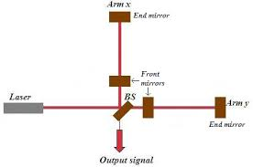
Introduction
f
Sub topic 1
Michelson-Fabry Perot Interferometer
Michelson vs Fabry Perot Interferometer
  Mirrors vs long-arm length
Which is ideal for Low Earth Orbit?
Can this be shortened?
[1] Schematic diagram of a Michelson interferometer with Fabry ... (n.d.). Retrieved April 5, 2022, from https://www.researchgate.net/figure/Schematic-diagram-of-a-Michelson-interferometer-with-Fabry-Perot-cavities_fig4_252633859

Slide 4
Introduction/Purpose
f
Sub topic 1
Local gas molecules
Solar winds, rocket turbulence...
Power supply supports operations
Detect interference from local disturbances
Survive conditions in Low Earth Orbit
Send data back to analyzer on Earth surface.

Slide 5
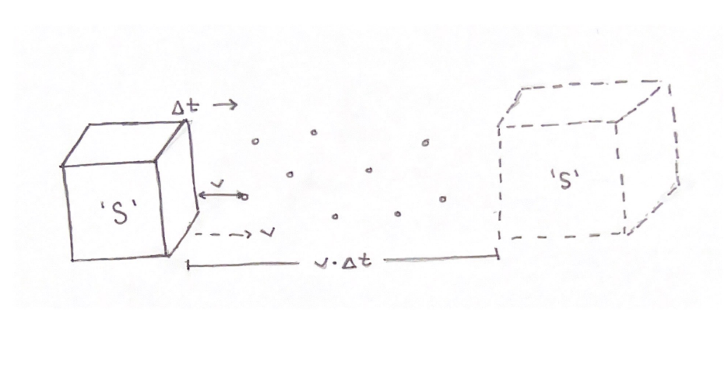
Potential Disturbances
f
Sub topic 1
Spacecraft (S) with area (A) encounters particles (N)
Figure 1

Slide 6
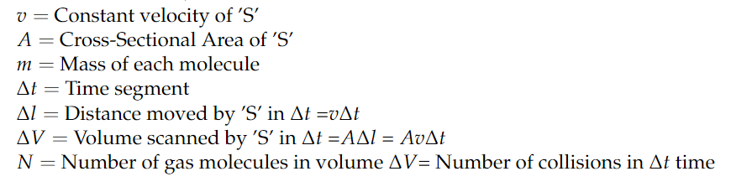
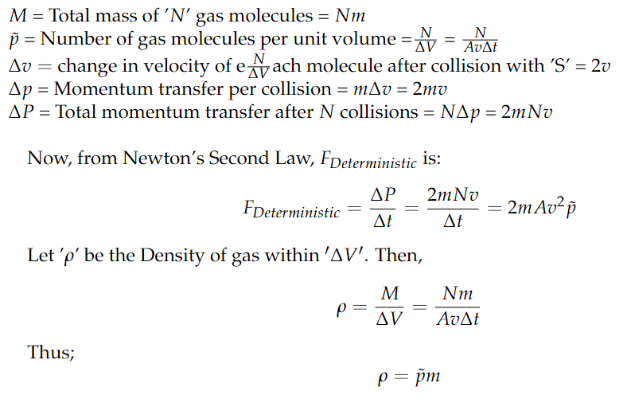
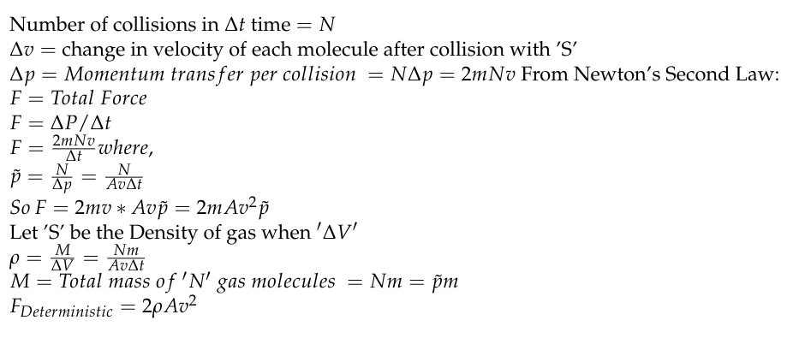

Potential Disturbances
f
Sub topic 1

Slide 7

Potential Disturbances
f
Sub topic 1
Stochastic force vs Deterministic Force
Poissonian Distribution
Brownian Distribution

Slide 8
Future Goals
f
Sub topic 1
Create a fully functional interferometer for a payload on a CubeSat mission
Establish what interferometer will perform with the best accuracy and precision in Low Earth Orbit
Determine the feasibility of detecting gravitational waves with a small arm-length interferometer
Analyze disturbances from low earth orbit environments
Project data onto Fourier transform for frequency domain analysis

Slide 9
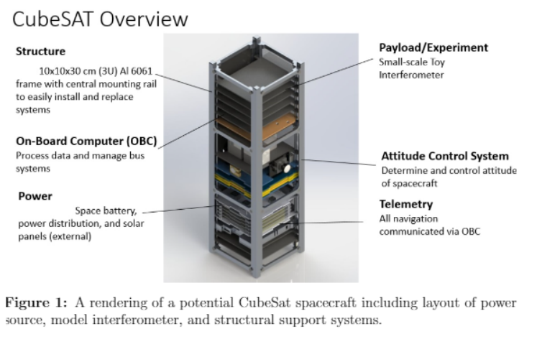
Goals
f
Sub topic 1
[2] Rendering of a potential CubeSat design courtesy of EagleSat

